Slide 1


SGC – session 3
Career Landscape
23rd Jan, 2021

Slide 2
Agenda
Key Roles Overview
Use Cases
Activity
Know Career Tracks
Skills & Competencies needed

Slide 3
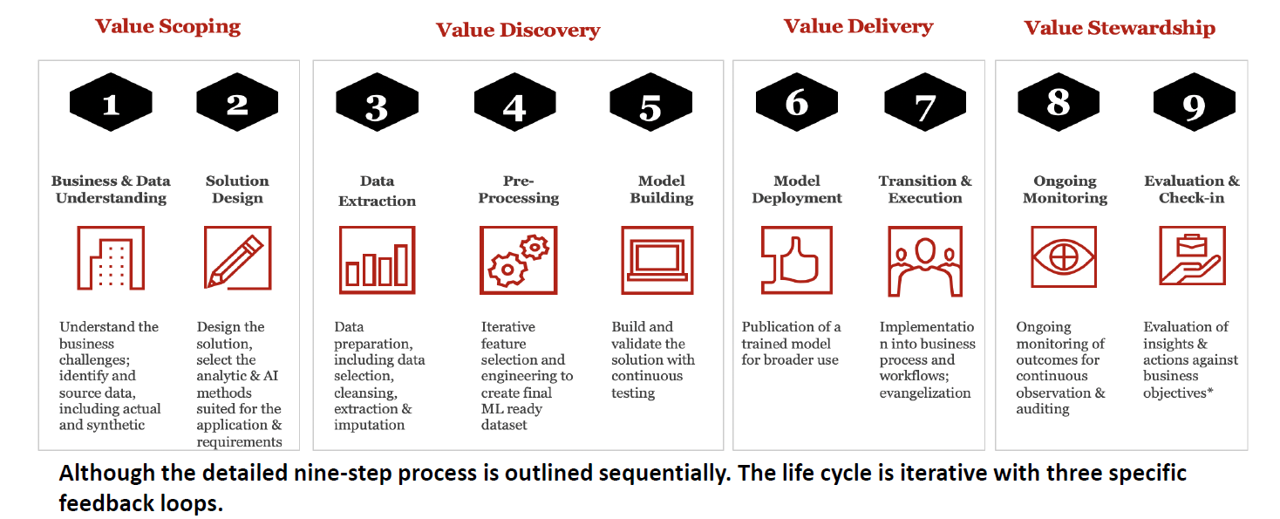
Lifecycle of a Data Science Project
CRISP -DM

Slide 4
Model Lifecycle

Slide 5
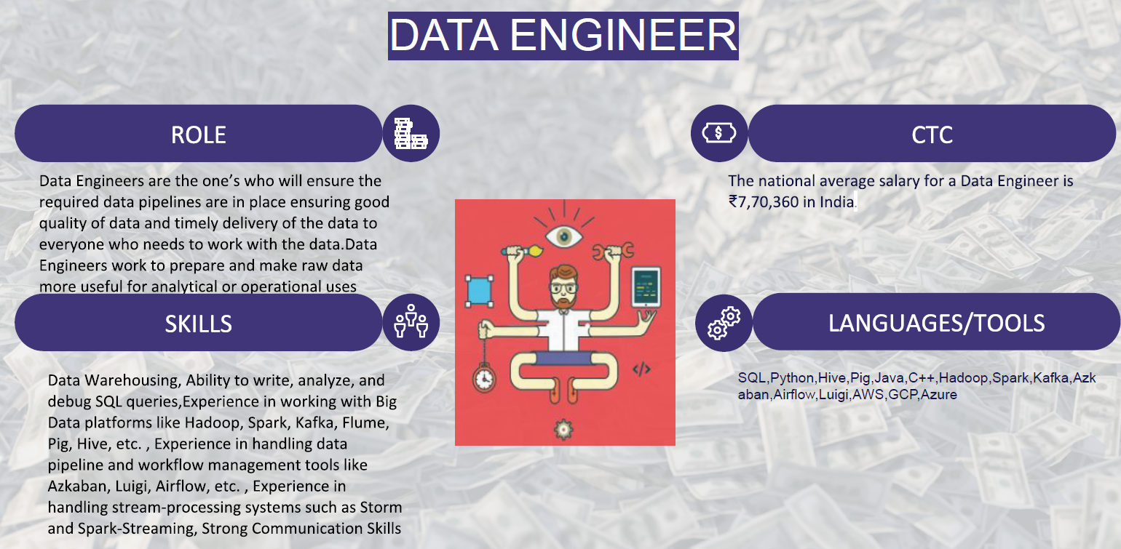
Roles

Slide 6
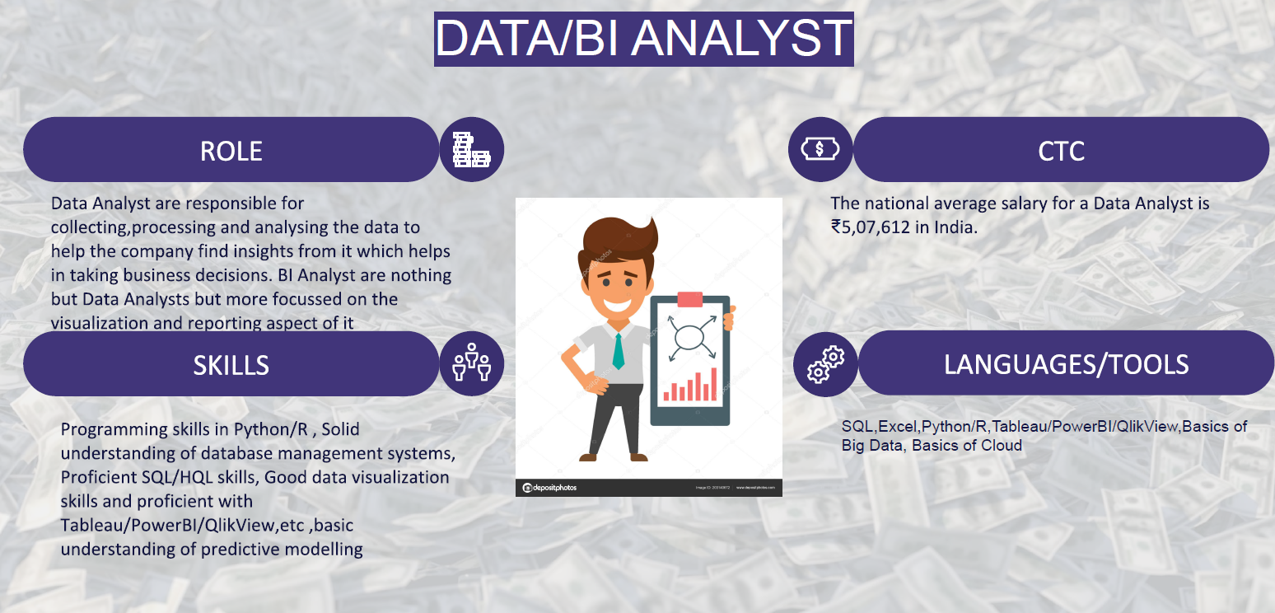
Roles

Slide 7
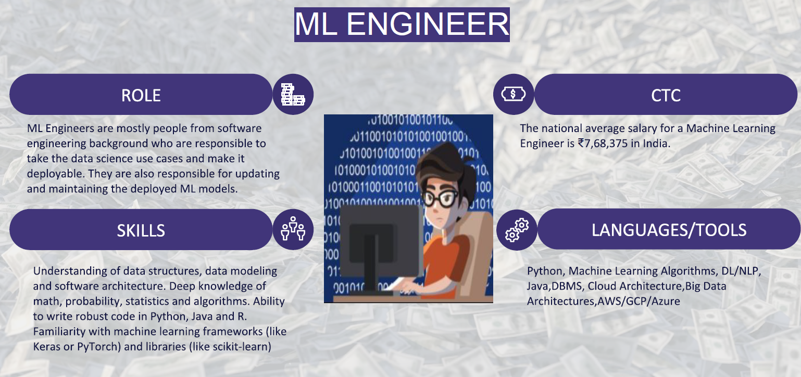
Roles

Slide 8
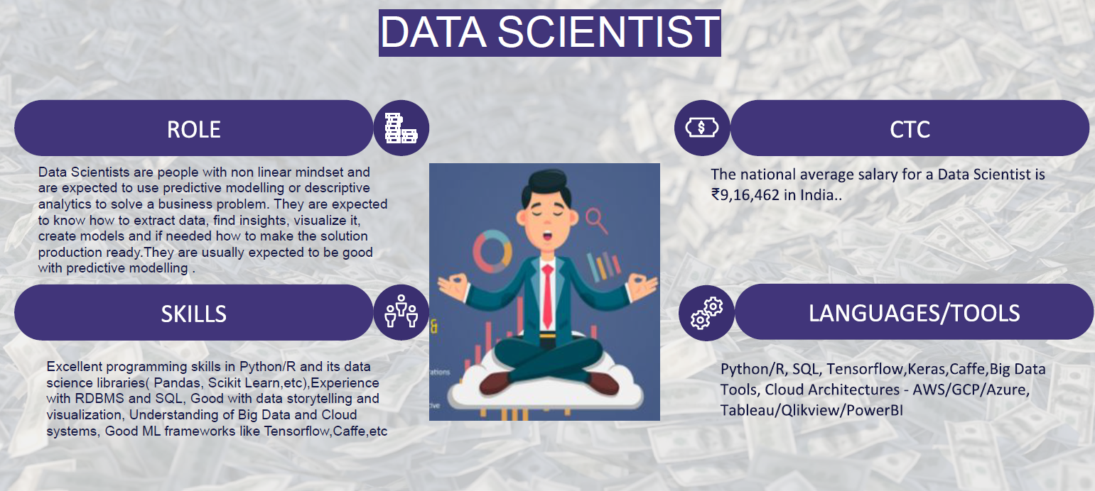
Roles

Slide 9
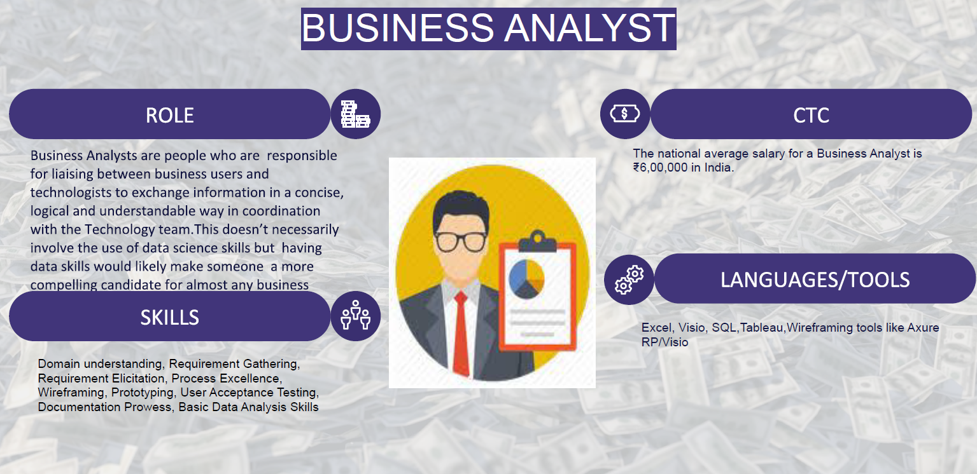
Roles

Slide 10
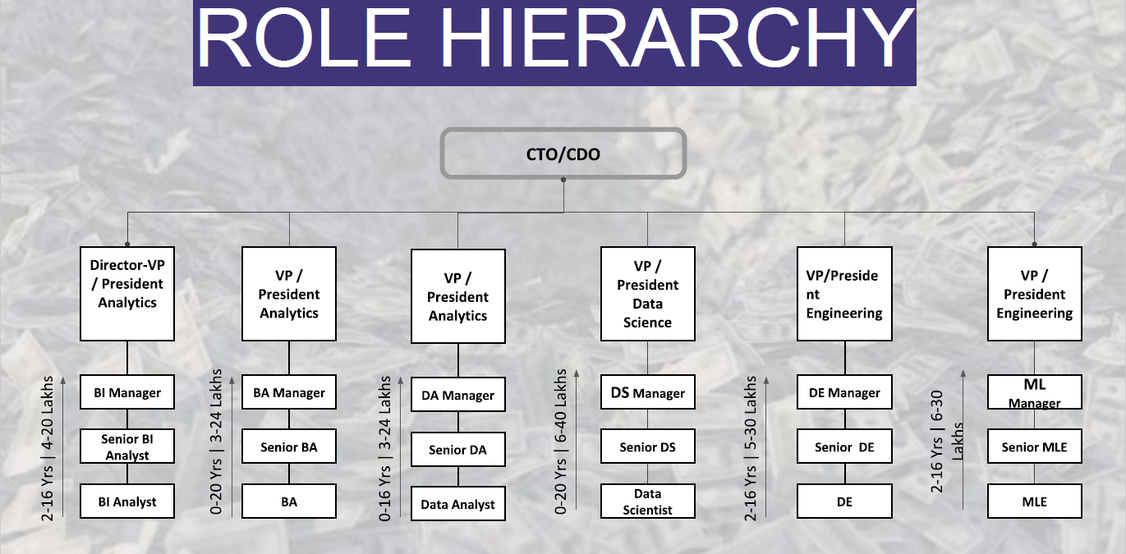
Roles Hierarchy

Slide 11
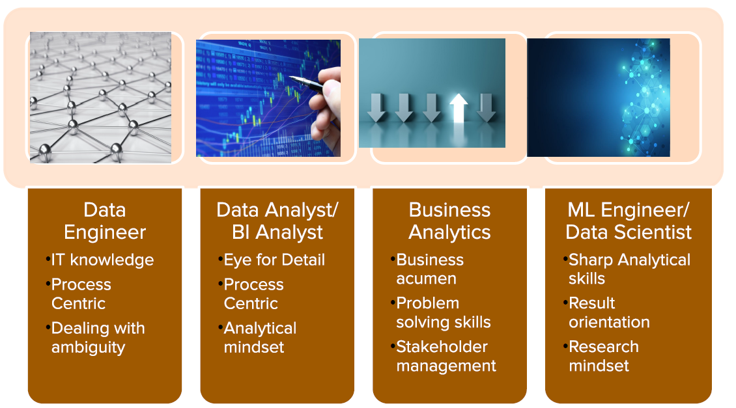
Soft Skills

Slide 12
Use Cases – Banking & Finance
Fraud Detection
Customer Segmentation
Risk Modelling
Personalized Marketing
Lifetime value prediction
Customer Support

Slide 13
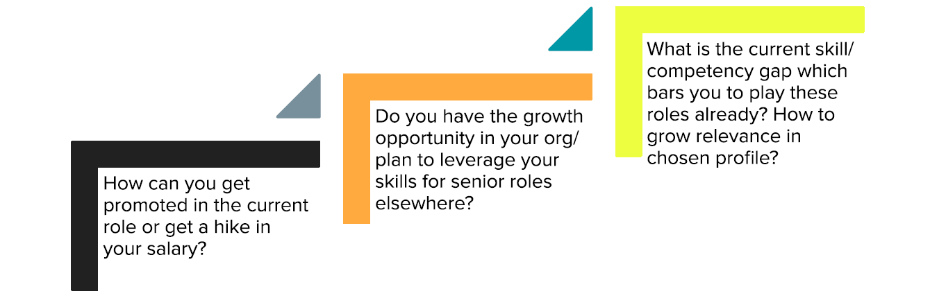
How to grow in current role

Slide 14
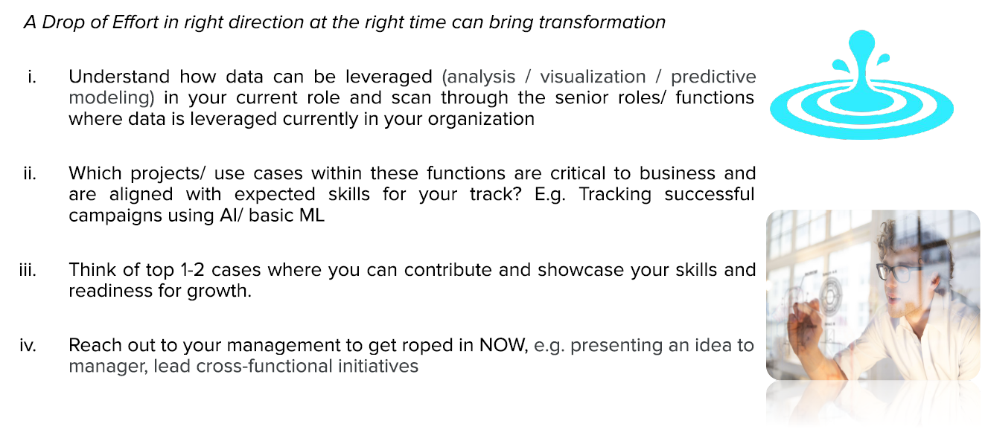
Activity Time
Top DS influencers to follow

Slide 15


